Slide 1
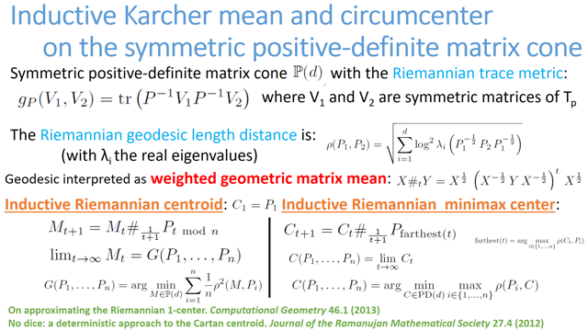

Slide 2
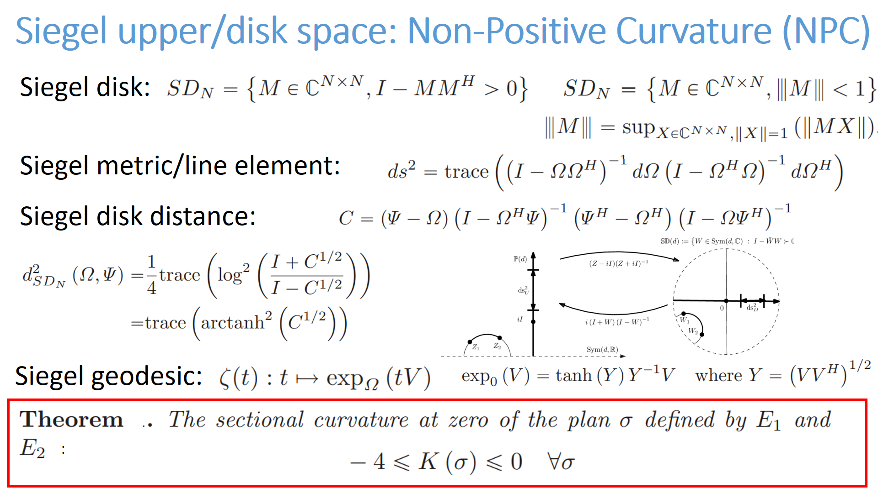

Slide 3
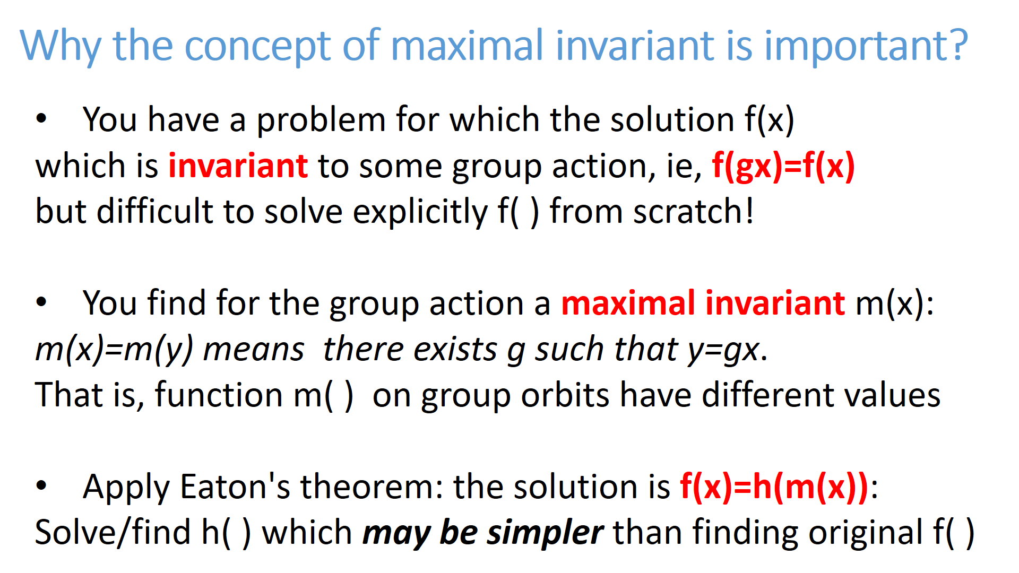
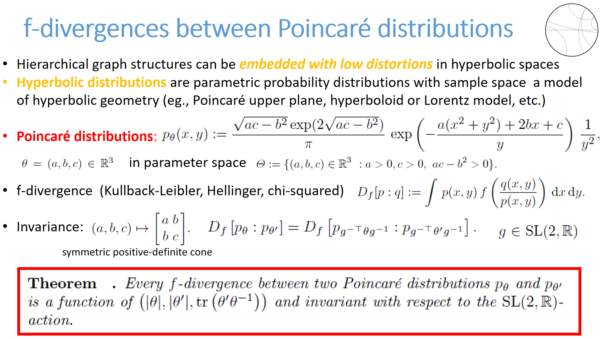

Slide 5
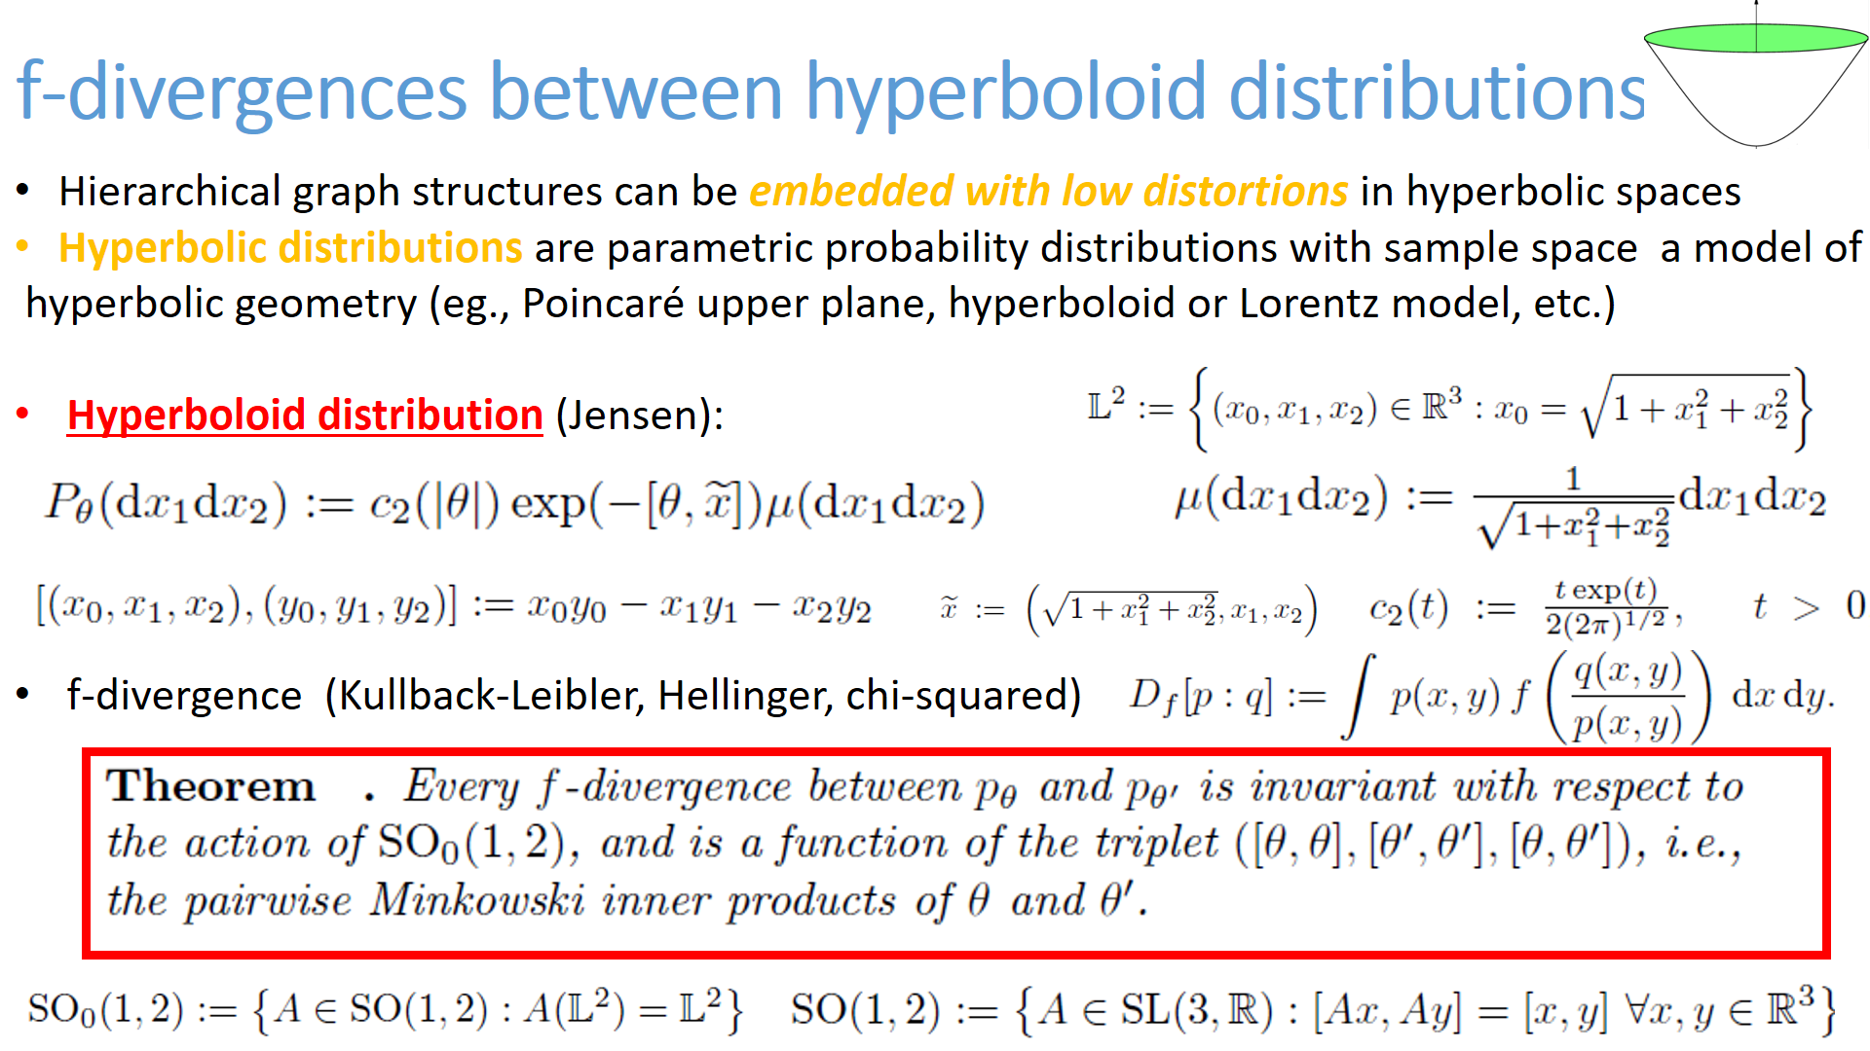

Slide 6
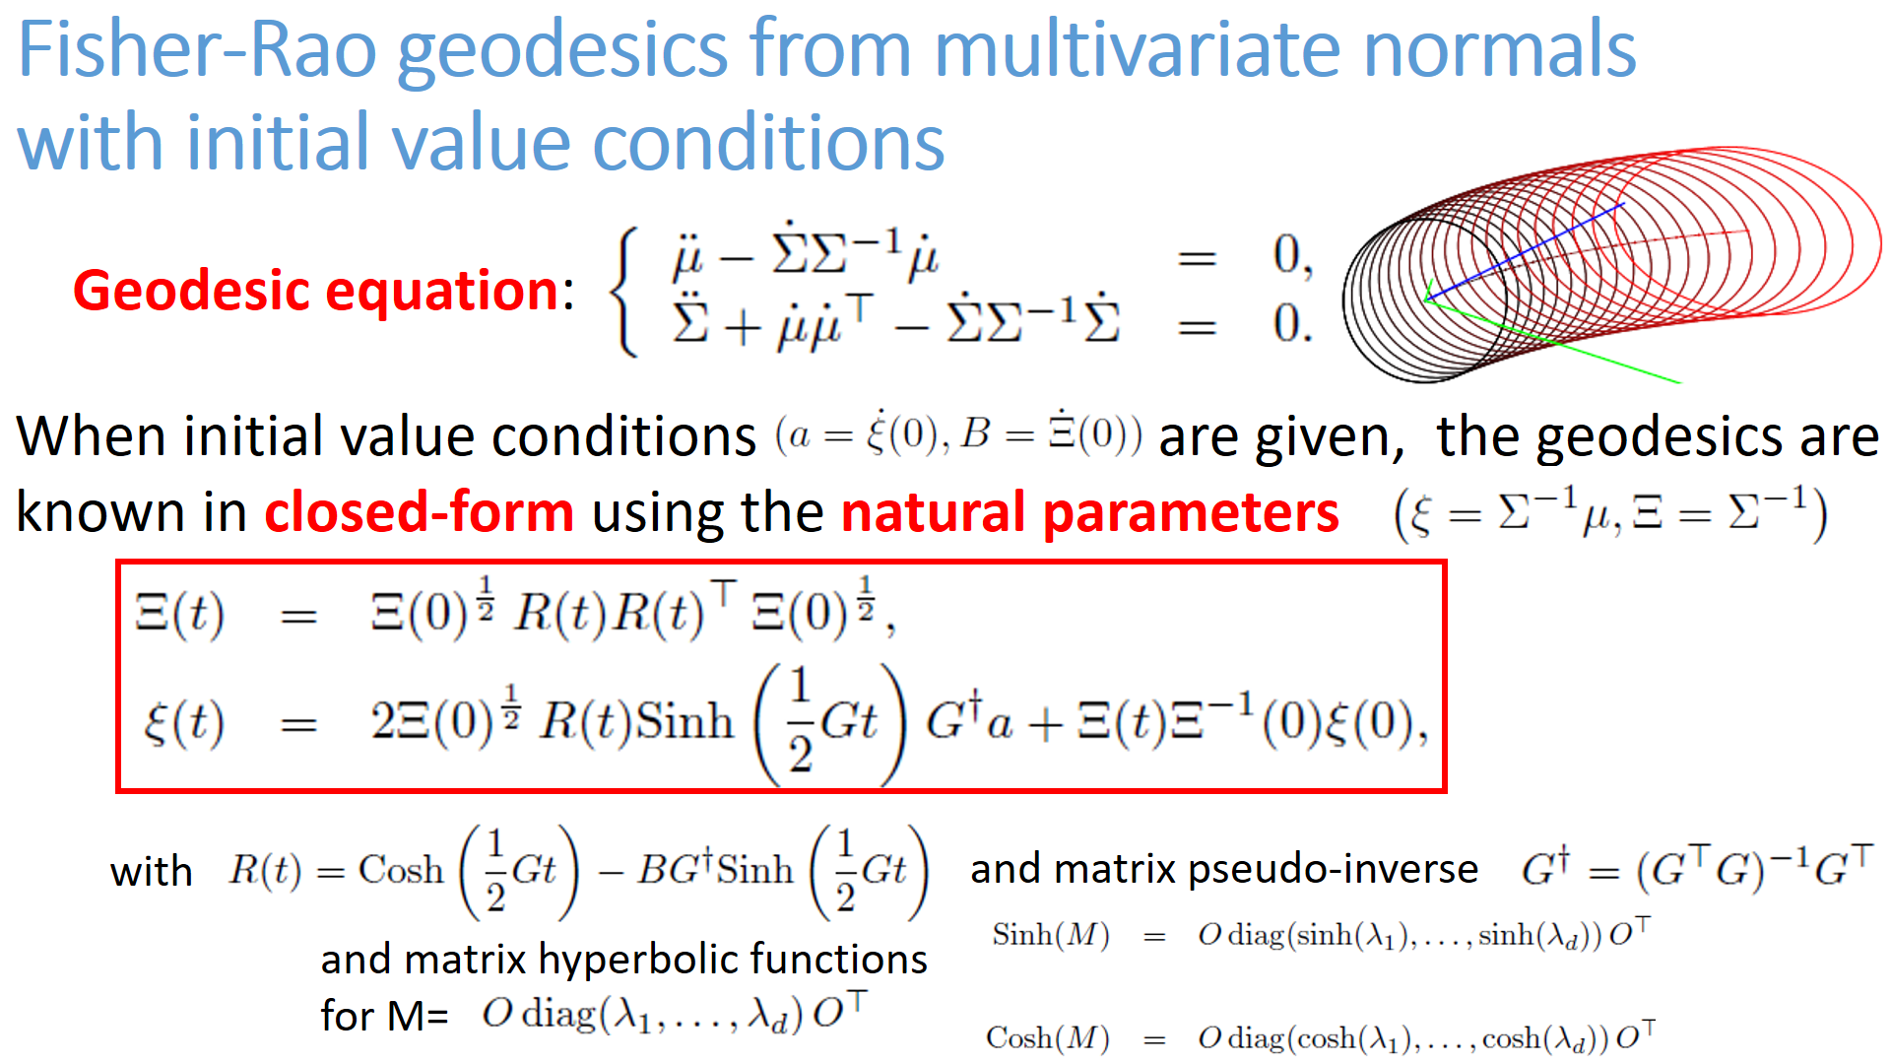

Slide 7
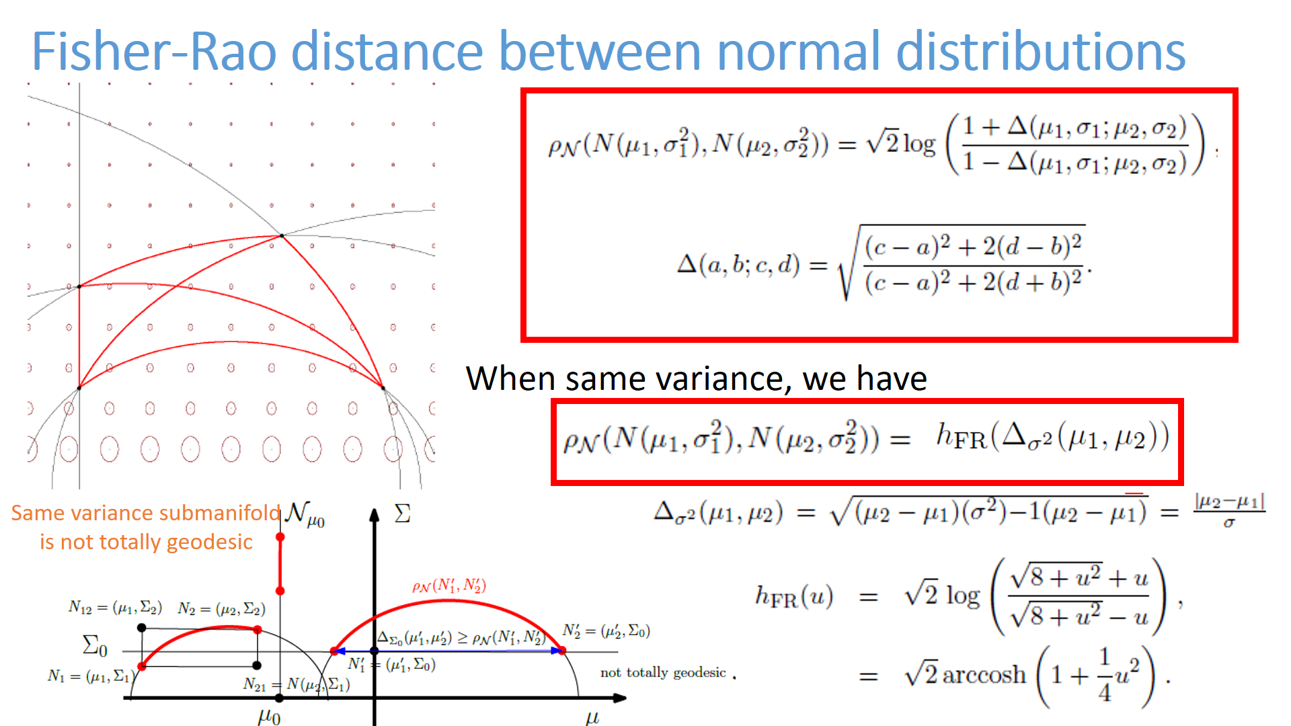

Slide 8
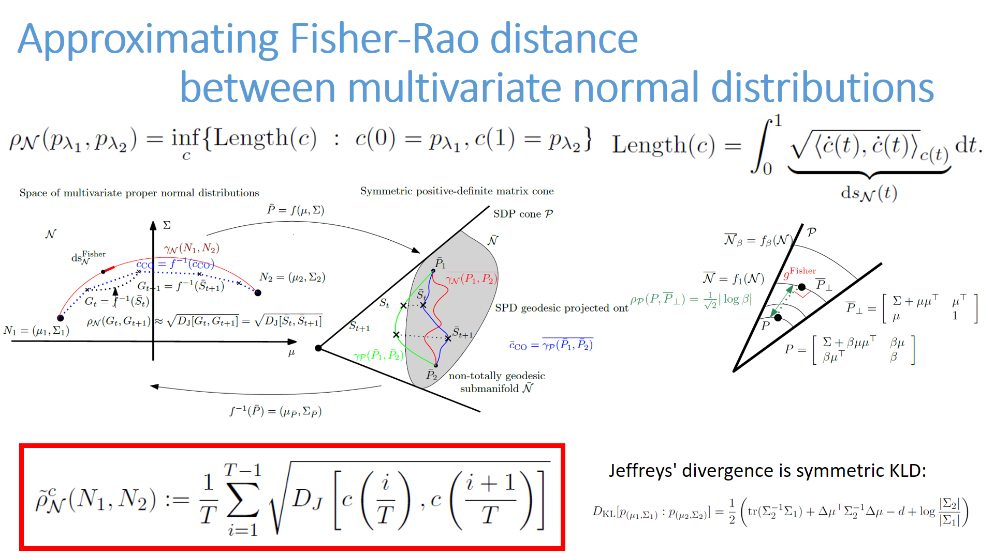

Slide 9
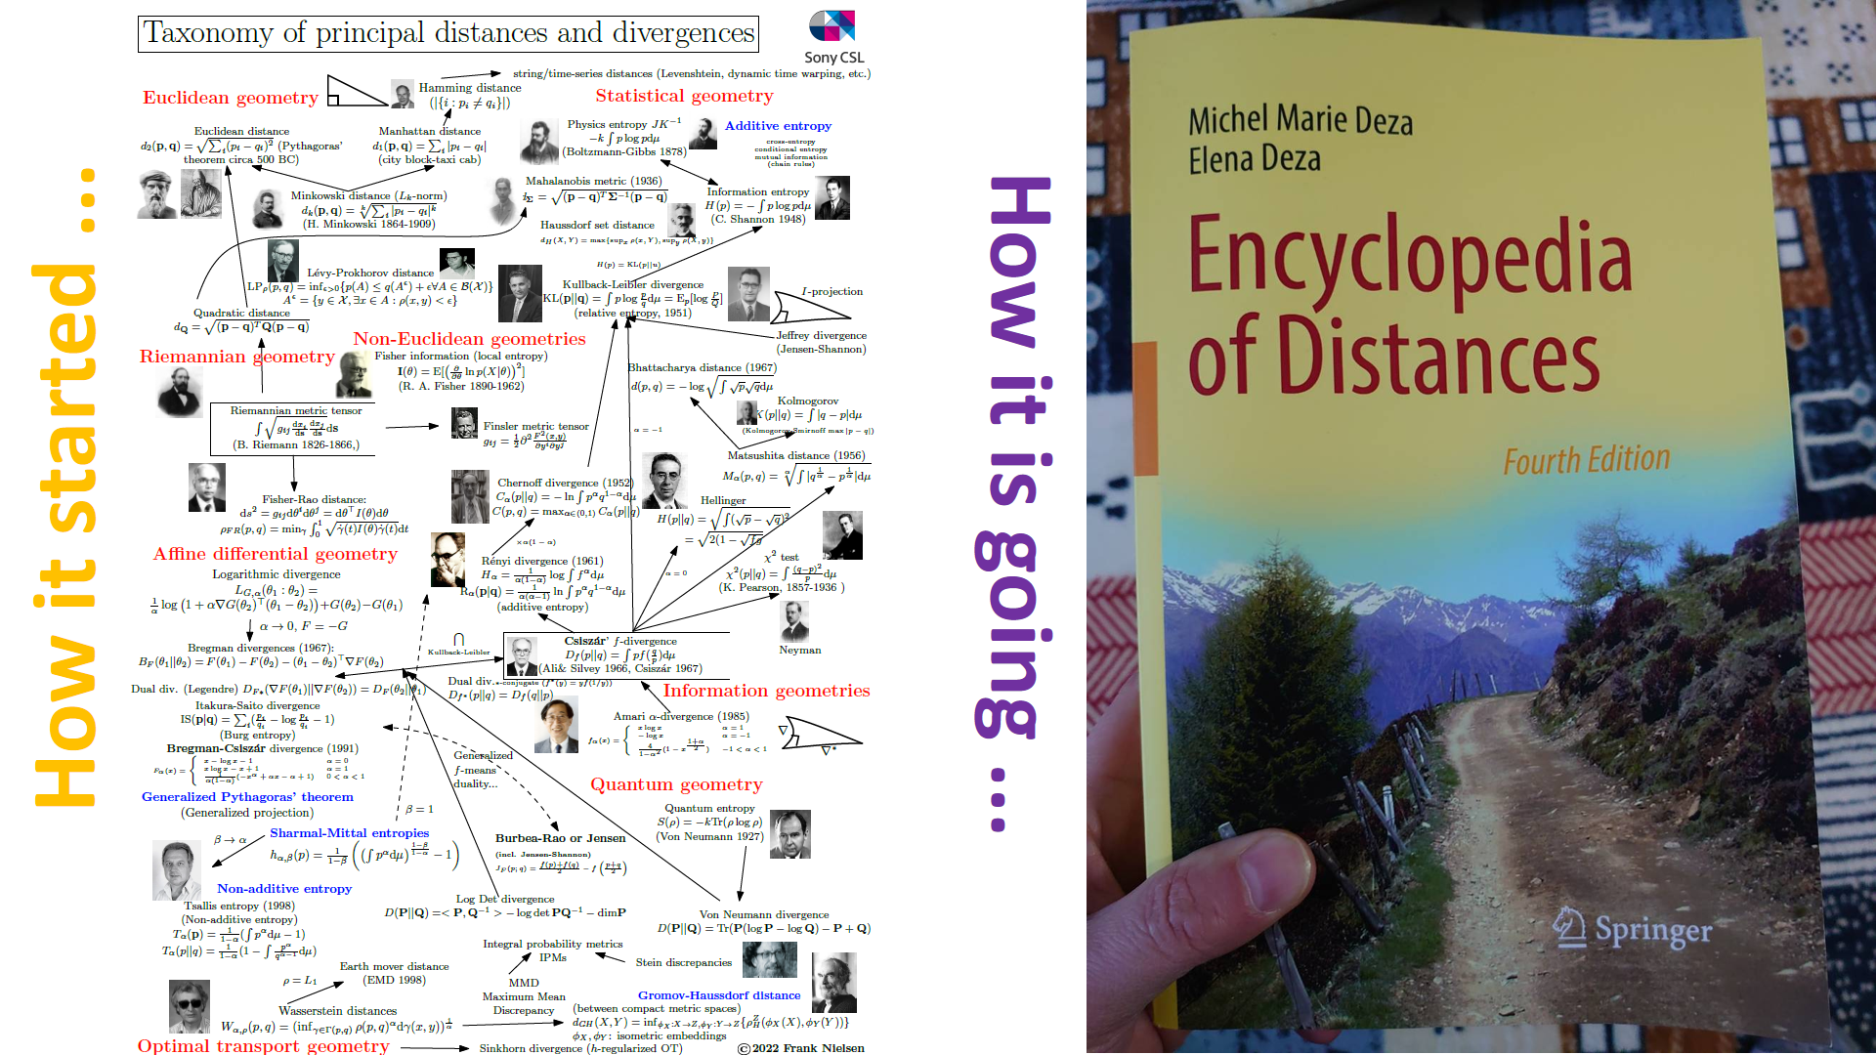

Slide 10
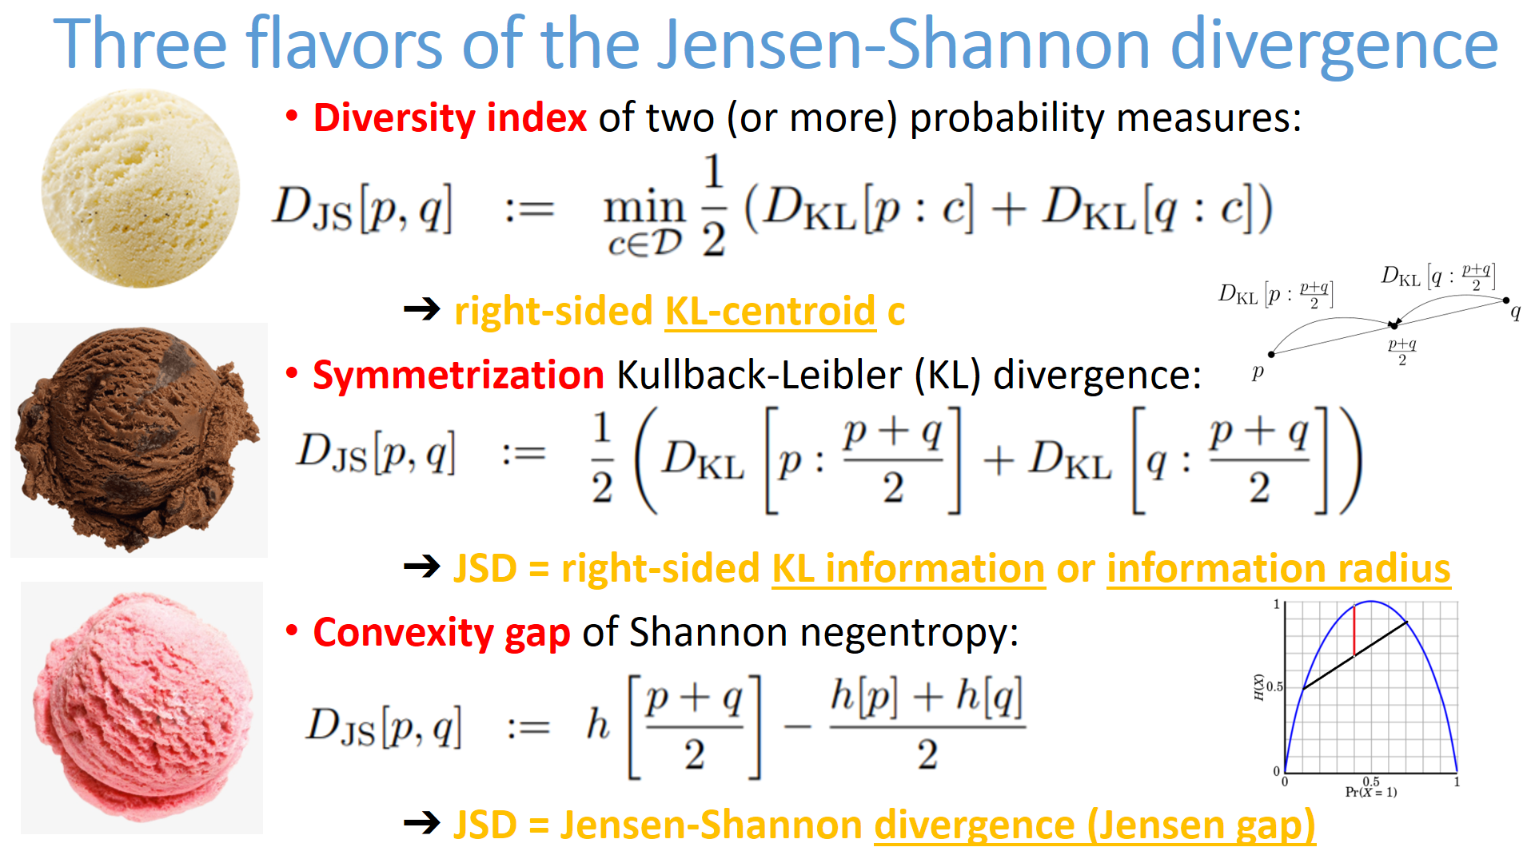

Slide 11
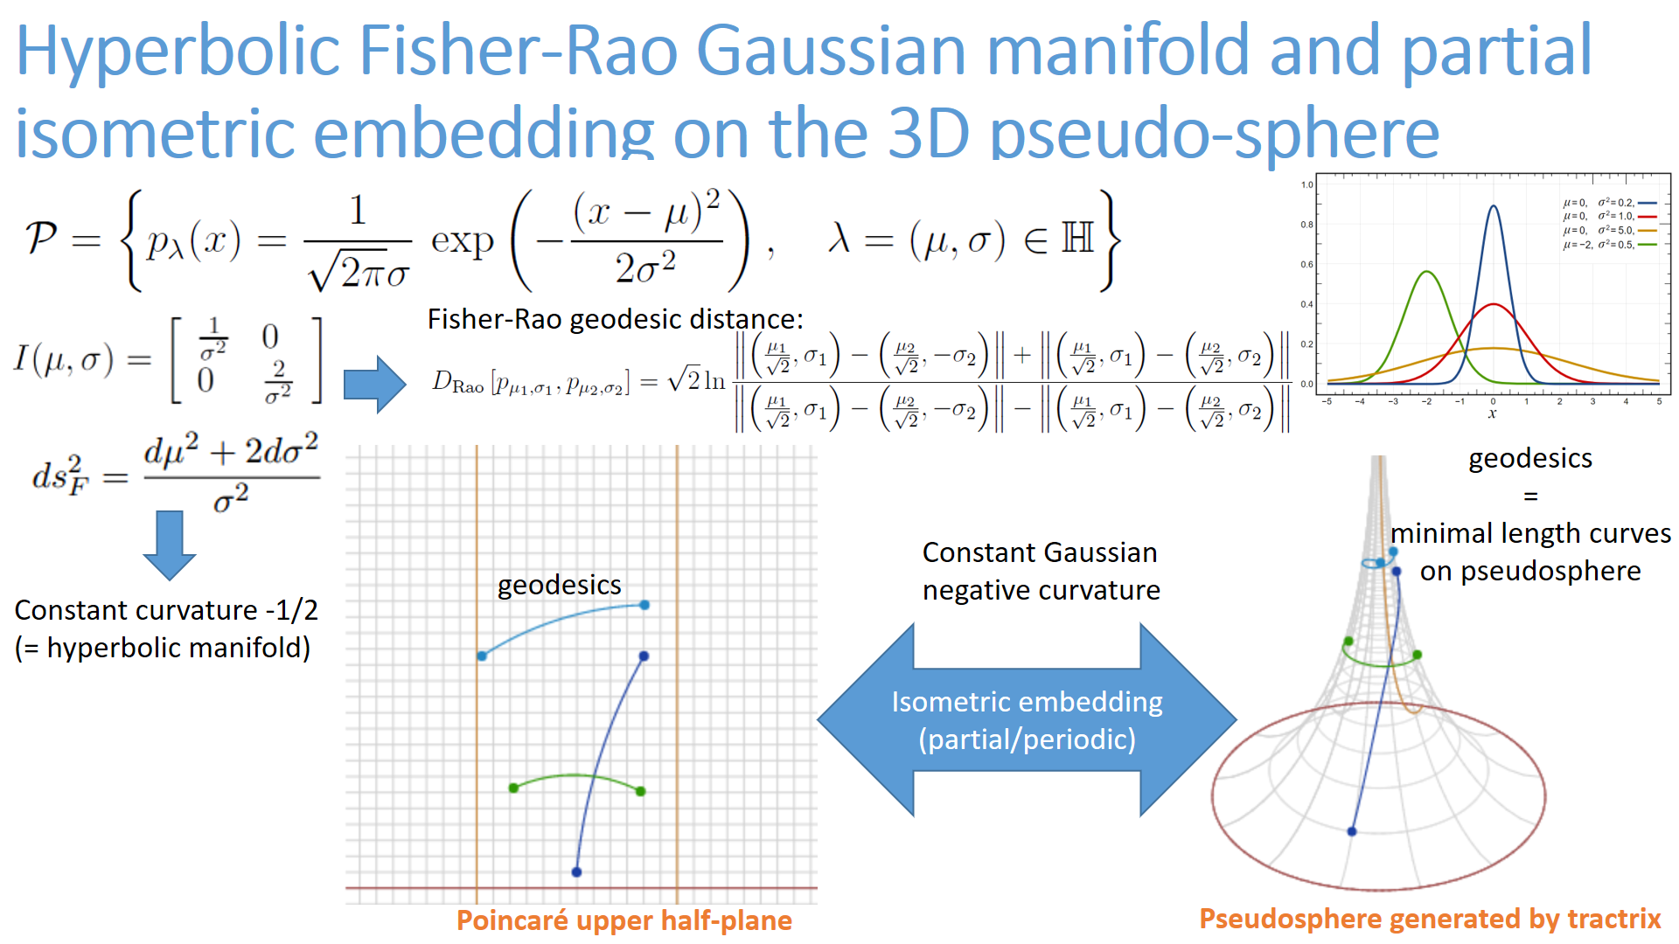

Slide 12
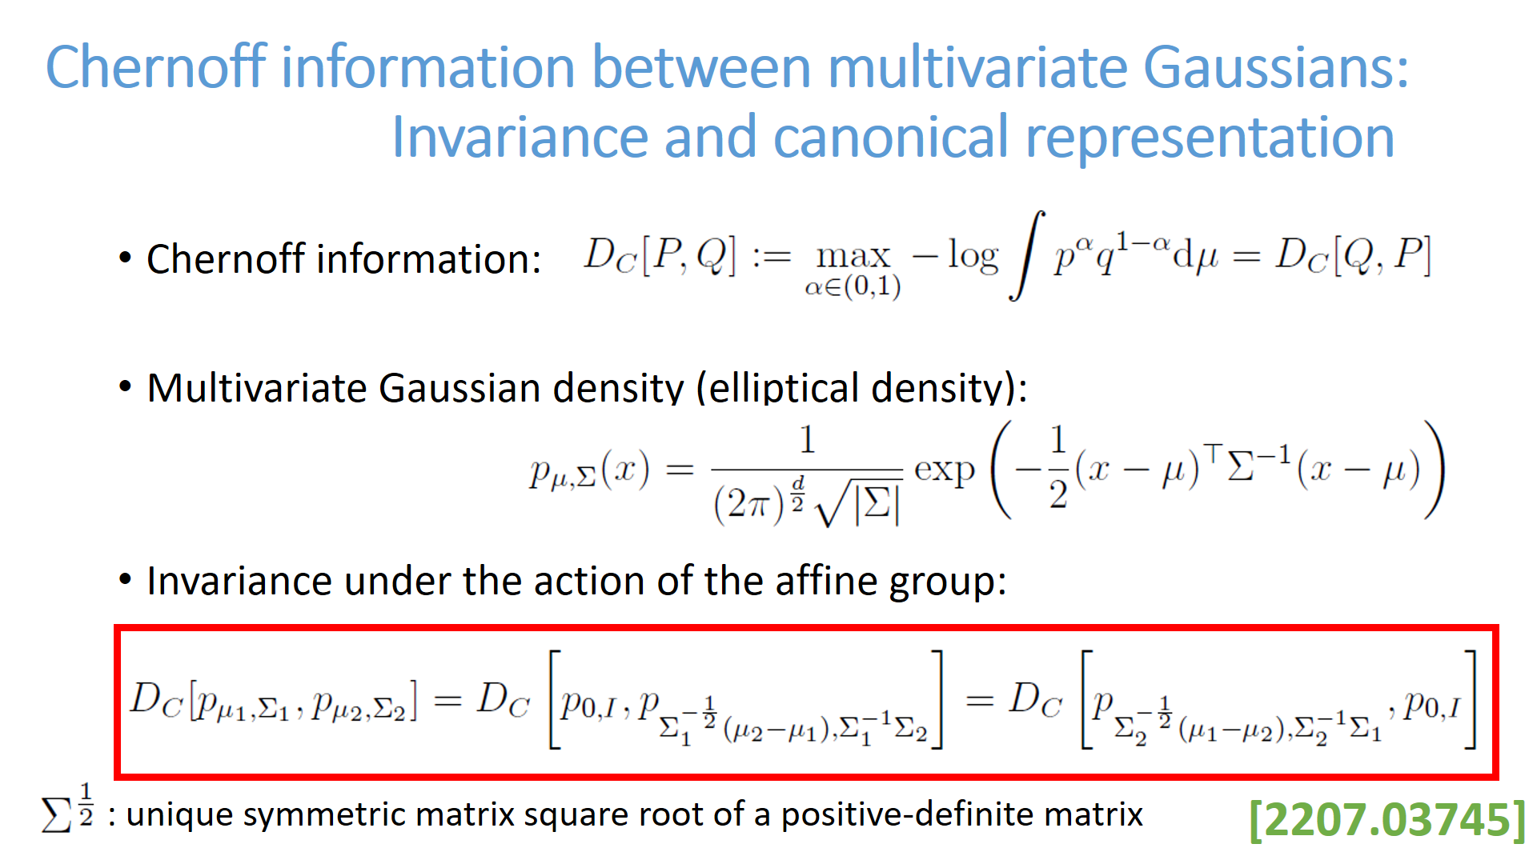

Slide 13
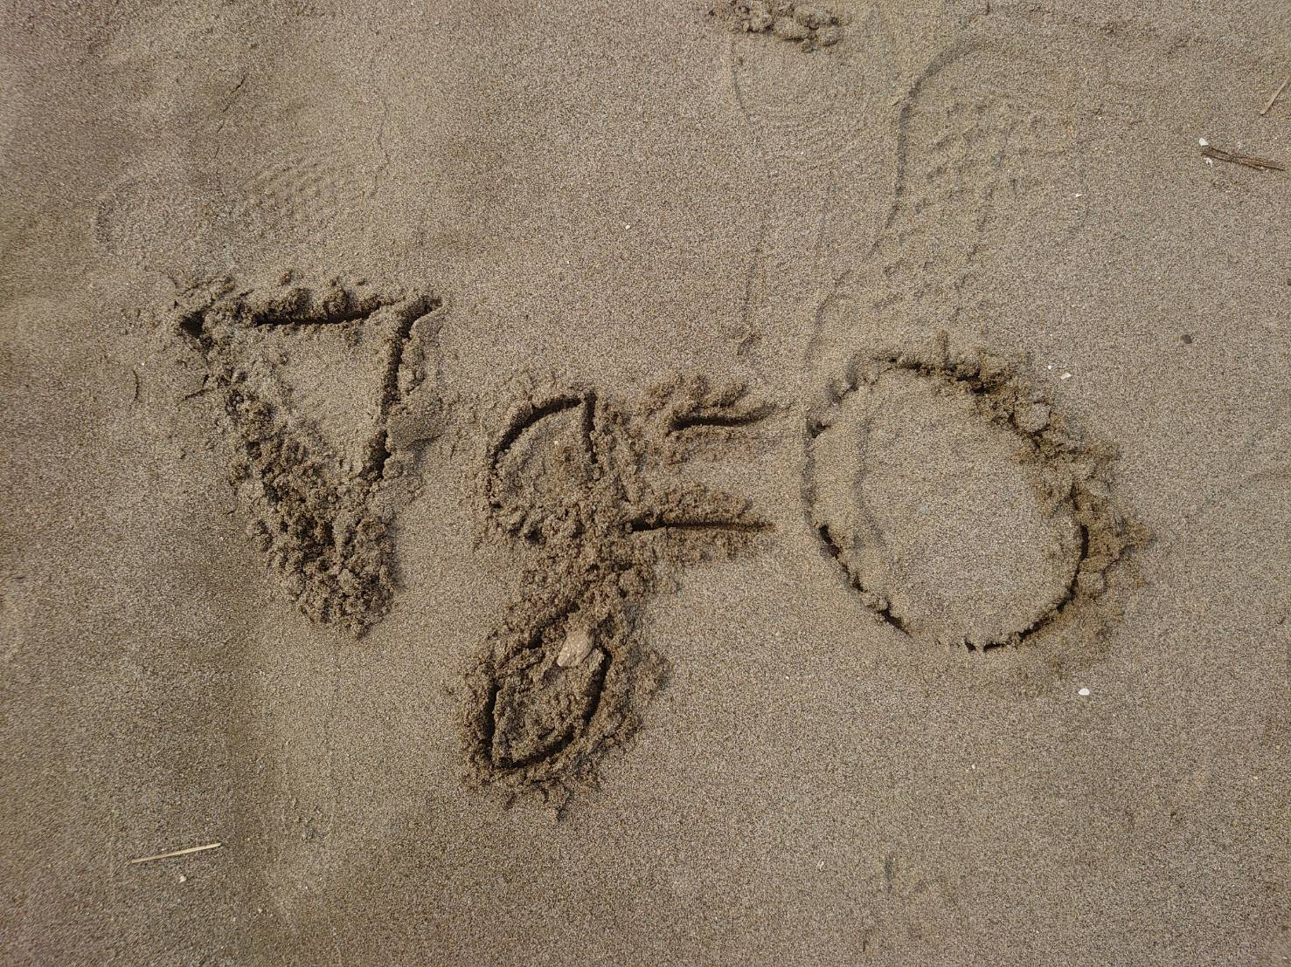


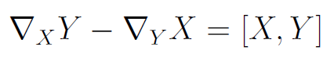

Fundamental theorem of Riemannian geometry
There exists a unique metric torsion-free connection ∇ induced
by the metric tensor g, called the Levi-Civita connection
3-covariant tensor ∇g acting on vector fields X, Y, and Z:
metric compatibility of ∇:
metric tensor g is preserved by parallel transport of ∇
Torsion-free ∇:
(Lie bracket)
Koszul formula defining ∇:
Notes:
Fundamental theorem of Riemannian geometry: There exists a unique metric torsion-free connection ∇ induced
by the metric tensor g, called the Levi-Civita connection given by the Koszul formula
$3$-covariant tensor acting on vector fields
$$
(\nabla g)(X,Y,Z) = X g(Y,Z)-g(\nabla_X Y,Z)-g(\nabla_X Z,Y)
$$
$$
\nabla g=0 \Longrightarrow X g(Y,Z) = g(\nabla_X Y,Z)+g(\nabla_X Z,Y)
$$
$$
\nabla_X Y-\nabla_Y X =[X,Y]
$$

